Slide 1

Compiler Design
Preet Kanwal
Department of Computer Science & Engineering
Teaching Assistant : Kavya P K

Slide 2

Compiler Design
Unit 3: L-Attributed SDD
Preet Kanwal
Department of Computer Science & Engineering

Slide 3
Compiler Design Lecture Overview
In this lecture, you will learn about -
What is an L-attributed SDD?
L–Attributed SDD Examples
Simple Type declaration
Array type Variable Declaration
Variable declaration verification
Desk calculator

Slide 4
Compiler Design Recap
Syntax Directed Definitions (SDD) are a generalization of context-free grammars in which -
Grammar symbols have an associated set of attributes
Productions are associated with Semantic Rules for computing the values of attributes.
Two kinds of attributes
Synthesized Attributes - computed from the values of the attributes of the children nodes and itself.
Inherited Attributes - computed from the values of the attributes of both the siblings and the parent nodes.
An SDD with only synthesized attributes is called an S-attributed definition.

Slide 5
Compiler Design
What is an L-attributed SDD?
A Syntax Directed Definition is L-attributed if all attributes are either -
Synthesized
Extended synthesized attributes, which can depend not only on attributes at the children, but on inherited attributes at the node itself
Inherited, but depending only on inherited attributes at the parent and any attributes at siblings to the left.

Slide 6
Compiler Design L-attributed SDD
The formal definition of an L-Attributed SDD is as follows -
A syntax directed definition is L-Attributed if each inherited attribute of X_{j} in a production A → X . . . X . . . X , depends only on -
1 j n
The attributes of the symbols to the left (this is what L in L-Attributed stands for) of X_{j} , i.e., X₁ X₂ . . . X_{j − 1}
The inherited attributes of A.
Theorem -
Inherited attributes in L-Attributed Definitions can be
computed by a PreOrder traversal of the parse-tree.

Slide 7
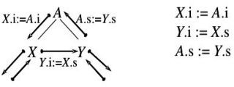
Compiler Design L-attributed SDD
L-attributed definitions
allow for the natural order of evaluating
attributes, i.e, depth first, left to right.
For example -
A → X Y

Slide 8
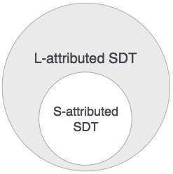
Compiler Design L-attributed SDD
Every S-attributed Syntax-Directed Definition is also L-attributed.

Slide 9
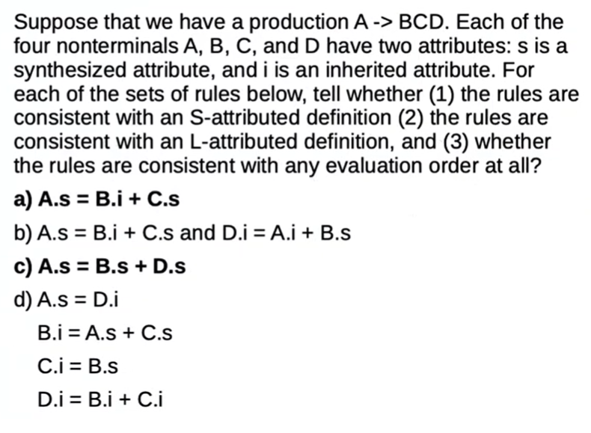
Compiler Design
L-attributed SDD Example

Slide 10
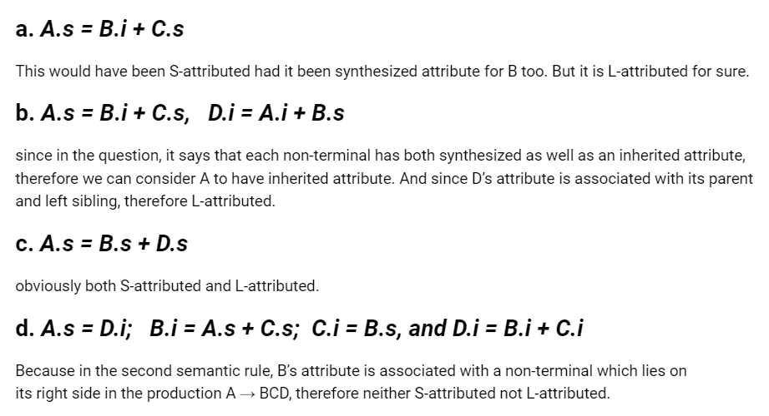

Slide 11
Compiler Design
L-Attributed SDD to implement a Simple Desk Calculator
Complete the semantic rules for the following L-attributed SDD. Evaluate the SDD for the input 3 + 5
Production | Semantic Rule
E → T E’
E’ → + T E’ 1
E' → λ
T → F T’
T → * F T’ 1
T’ → λ
F → num

Slide 12
Compiler Design
L-Attributed SDD to implement a Simple Desk Calculator
Production | Semantic Rule
E → T E’ | { E’.inhval = T.val; E.val = E’.val; }
E’ → + T E’ 1 | { E’ .inhval = E’.inhval + T.val; 1 E’.val = E’ .val; } 1
E' → λ | { E’.val = E’ .inhval; }
T → F T’ | { T’.inhval = F.val; T.val = T’.val; }
T'→ * F T’ 1 | {T’ .inhval = T’.inhval * F.val; 1 T’.val = T’ .val; } 1
T’ → λ | { T’.val = T’.inhval }
F → num | { F.val = num.lexval }
This is an LDD - In E → T E’,
the attribute for E’ is inherited from T, which is the left-sibling.

Slide 13
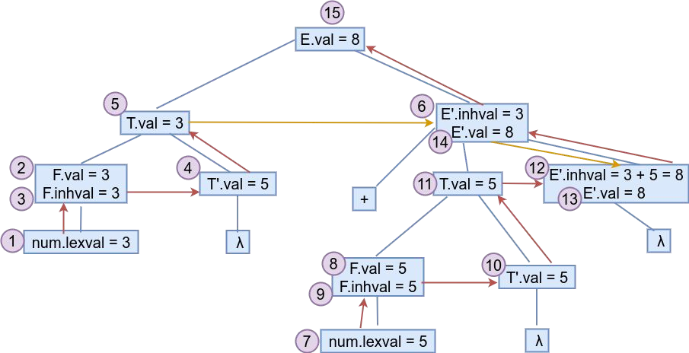
Compiler Design
L-Attributed SDD to implement a Simple Desk Calculator -Wrong
Evaluate the SDD for the input 3 + 5

Slide 14
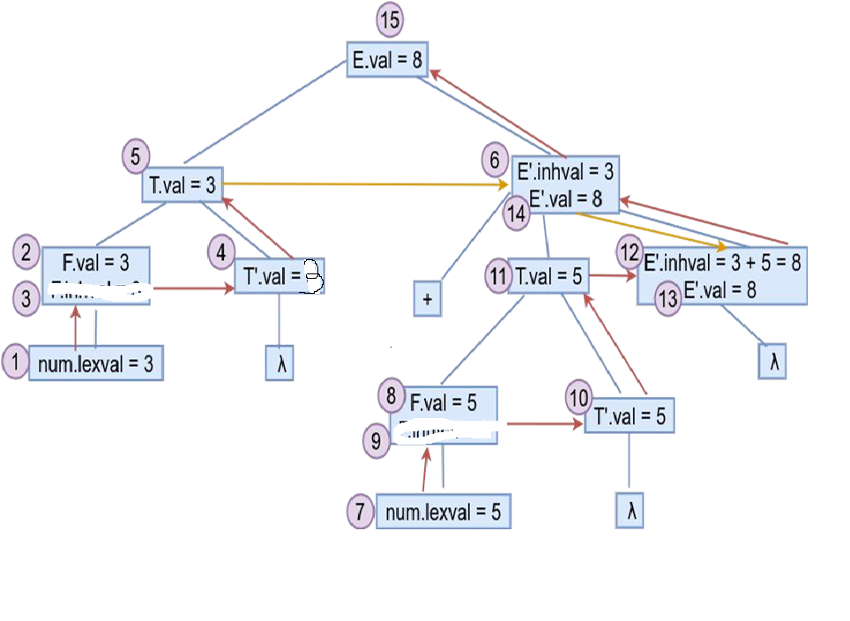
Compiler Design
L-Attributed SDD to implement a Simple Desk Calculator – Corrected one
Production | Semantic Rule
E → T E’ | { E’.inhval = T.val; E.val = E’.val; }
E’ →+ T E’ 1 | { E’ .inhval = E’.inhval + T.val; 1 E’.val = E’ .val; } 1
E → λ | { E’.val = E’ .inhval; } 1
T → F T’ | { T’.inhval = F.val; T.val = T’.val; }
T →* F T’ 1 | {T’ .inhval = T’.inhval + F.val; 1 T’.val = T’ .val; } 1
T’ → λ | { T’.val = T’.inhval }
F → num | { F.val = num.lexval }
Evaluate the SDD for the input 3 + 5
T’.inhval=3
T’.inhval=5

Slide 15
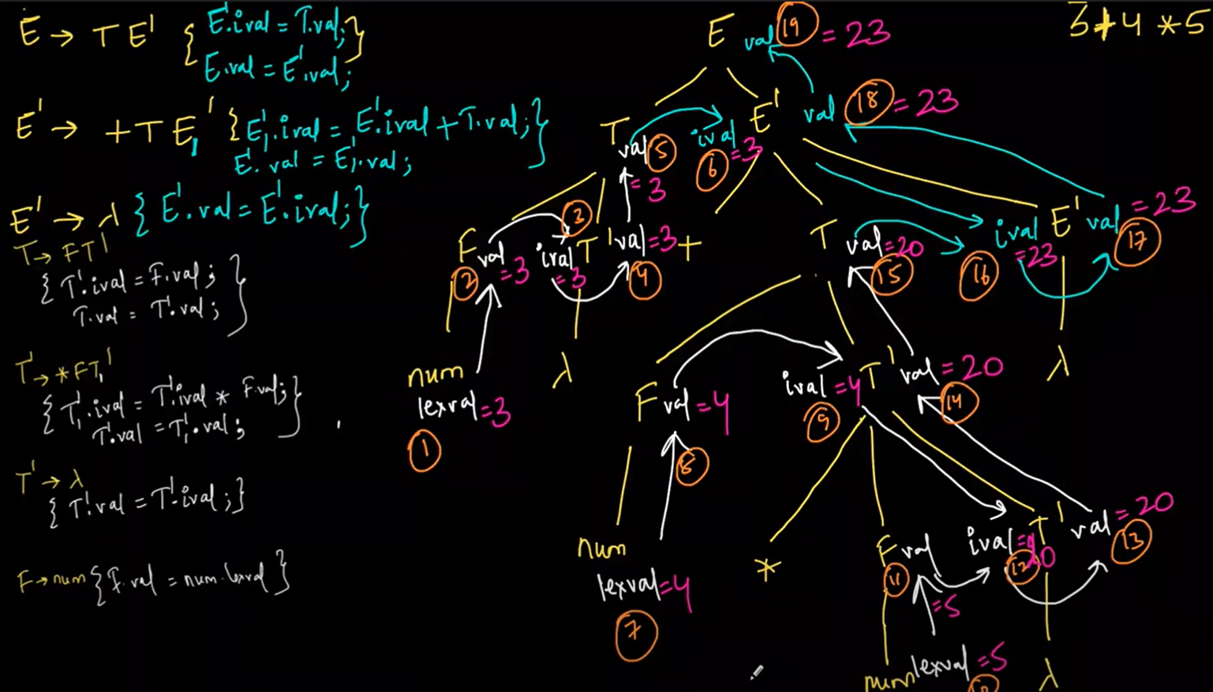
Compiler Design
L-Attributed SDD to implement a Simple Desk Calculator – 3+4*5
Evaluate the SDD for the input 3 + 5
T’.inhval=3
T’.inhval=5

Slide 16
Compiler Design
L-attributed SDD for Simple Type declaration
Complete the semantic rules for the following L-attributed SDD. Evaluate the SDD for the input int a,b
Production | Semantic Rule
D → T L
T → int
T → float
L → L , id 1
L → id

Slide 17
Compiler Design
L-attributed SDD for Simple Type declaration
Production | Semantic Rule
D → T L | { L.inhType = T.type; L.inhWidth = T.width; }
T → int | { T.type = integer; T.width = 4;}
T → float | { T.type = float; T.width = 8; }
L → L , id 1 | { L₁.inhType = L.inhType; L₁.inhWidth = L.inhWidth; update(id.entry, L.inhType,L.inhWidth); }
L → id | {update(id.entry, L.inhType,L.inhWidth); }
This is an LDD -
In D → T L, the attribute for L is inherited from T, which is the left-sibling.
update() is used to update type and storage in the symbol table.

Slide 18
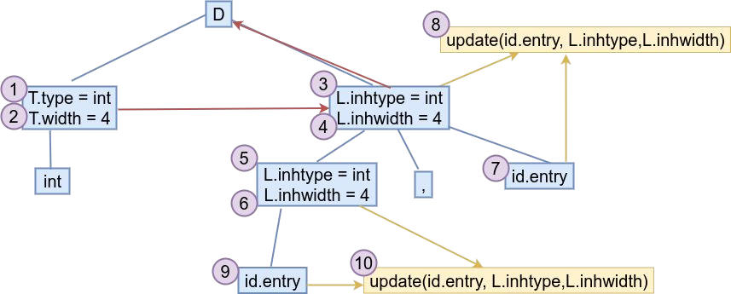
Compiler Design
L-attributed SDD for Simple Type declaration
Evaluate the SDD for the input int a,b;

Slide 19
Compiler Design
L-attributed SDD to identify Array Type
Complete the semantic rules for the following L-attributed SDD. Evaluate the SDD for the input int a[2][3]
Production | Semantic Rule
T → B C
B → int
B→ float
C → [num] C 1
C → λ

Slide 20
Compiler Design
L-attributed SDD to identify Array Type
Production | Semantic Rule
T → B C | { C.inhType = B.type; C.inhWidth = B.width; T.type = C.type; T.width = C.width; }
B → int | { B.type = integer; B.width = 4;}
B→ float | { B.type = float; B.width = 8; }
C → [num] C 1 | { C₁.inhType = C.inhType; C₁.inhWidth = C.inhWidth; C.type = array(num.lexval , C₁.type); C.width = num.lexval * C₁.width ;); addType(id.entry, C.inhType); addWidth(id.entry, C.inhWidth; }
C → λ | { C.type = C.inhType; C.width = C.inhWidth; }

Slide 21
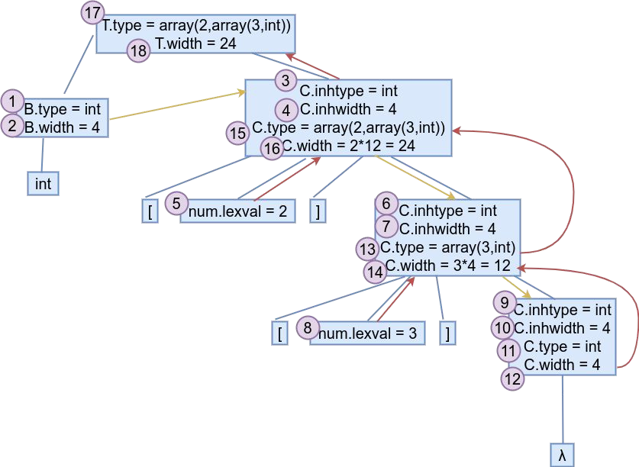
Compiler Design
L-attributed SDD for Simple Type declaration
Evaluate the SDD for the input int a[2][3] int a[2][3] translates to array(2,array(3,int))

Slide 22
Compiler Design
L-attributed SDD for Basic vs Array Type declaration in C Semantics
Construct an SDD to identify an array of the following format - float x[4] , y
Follow C Semantics - i.e, x is an array type, y is a basic type
Production | Semantic Rule
D→ T L
T → B C
B → int
B→ float
C → [num] C 1
C → λ
L → L , id 1
L → id

Slide 23
Compiler Design
L-attributed SDD for Basic vs Array Type declaration in C Semantics
Production | Semantic Rule
D→ T L | { L.inhType = T.type; L.inhWidth = T.width; L.inhbasicType = T.basicType; L.inhbasicWidth = T.basicWidth; }
T → B C | { C.inhType = B.type; C.inhWidth = B.width; T.type = C.type; T.width = C.width; T.basicType = B.type; T.basicWidth = B.width;}
B → int | { B.type = integer; B.width = 4;}
B→ float | { B.type = float; B.width = 8; }
C → [num] C 1 | { C₁.inhType = C.inhType; C₁.inhWidth = C.inhWidth; C.type = array(num.lexval , C₁.type); C.width = num.lexval * C₁.width; }
C → λ | { C.Type = C.inhType; C.Width = C.inhWidth; }

Slide 24
Compiler Design
L-attributed SDD for Basic vs Array Type declaration in C Semantics
Production | Semantic Rule
… | …
L → L , id 1 | L₁.inhType = L.inhType; L₁.inhWidth = L.inhWidth; L₁.inhbasicType = L.inhbasicType; L₁.inhbasicWidth = L.inhbasicWidth; addType(id.entry, L.inhbasicType); addWidth(id.entry, L.inhbasicWidth;
L → id | { addType(id.entry, L.inhType); addWidth(id.entry, L.inhWidth; }

Slide 25
THANK YOU
Preet Kanwal
Department of Computer Science & Engineering
preetkanwal@pes.edu

